Slide 1
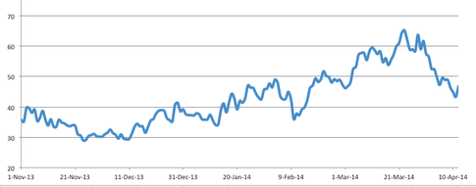
Welcome to the Statistics Major Orientation!

Slide 2
Why Study Statistics?

Slide 3
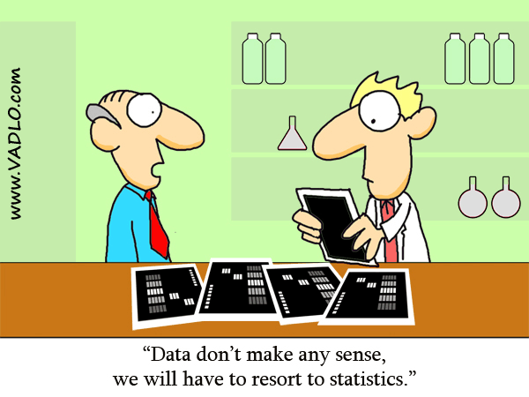

Slide 4
What Is Statistics?
The field of statistics provides the scientist with some of the most useful techniques for evaluating ideas, testing theory, and discovering the truth.
We live in an information age. We can start to make sense of it.
It is important for researchers and also consumers of research to understand statistics so that they can be informed, evaluate the credibility and usefulness of information, and make appropriate decisions.
Excellent career prospects ☺

Slide 5
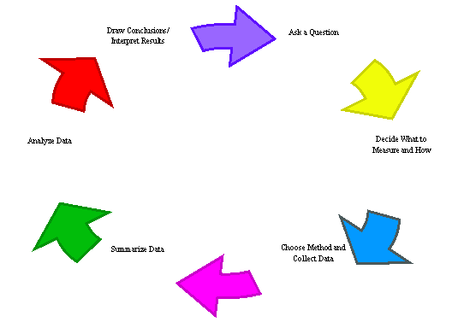

Slide 6
Welcome to Statistics!

Slide 7
Application Requirements
STATISTICS IS A COMPETITIVE MAJOR!
Application Deadline: First Friday of September. Once a year!
Summer Quarter policy: If you take Summer Quarter classes, you must wait to apply until after your Summer Quarter grades are included on your transcript. (This wait will not delay the consideration of your application.)

Slide 8
Admission Requirements
MATH 124, MATH 125, MATH 126 (or MATH 134, MATH 135, MATH 136)
One of the following: STAT 311 (highly recommended), STAT 390, or an approved substitute
At least two additional courses from CSE 142, (CSE 143), MATH 307, and MATH 308
Factors in the admission decision include academic performance as measured by GPA in courses listed above and any additional advanced quantitative courses presented for application consideration
Successful applicants typically have a cumulative GPA higher than 3.00 in courses listed above under course requirements, with no individual course grade lower than 2.5

Slide 9
DECLARING THE MAJOR
Potential Bottleneck:
Demand for MATH 300, MATH 327 and STAT 340 (taken in this order) is large enough that you may have to be an officially declared Statistics major even to enroll in MATH 300. Priority for enrollment in Math 300 is given to declared majors in various Mathematical Sciences.
Suggested Program:
- Take CSE 142 and MATH 307 in Freshman year.
- Get into STAT major as soon as possible in order to secure a timely enrollment in MATH 300, and it could be essential in order to complete a Statistics major in 4 years.

Slide 10
Suggested 1st & 2nd Year Courses
CSE 142, MATH 307, MATH 308, STAT 311.
* Additional courses in the sciences and quantitative methods add strength to this major.*

Slide 11
Suggested Schedule

Slide 12
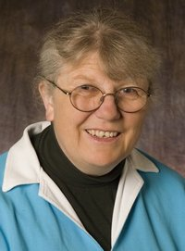
Department Stars
Mee-Ling Hon
Academic Counselor, Undergraduate Program
Administrative Staff
Peter Guttorp
Professor
2007 Nobel Peace Prize
Galen Shorack
Professor
Founding member of the Department of Statistics (UW)
Elizabeth Thompson
Professor
President of International Biometric Society

Slide 13
On track for the STAT major

Slide 14
Main Series
Starting from Junior fall quarter, one class per quarter: STAT 340, 341, 342, 421, 423
MATH/STAT 394-395 option

Slide 15
Supplemental Classes
MATH 327-328 both required
STAT 302 required; only offered in winter
- Alternatively, CSE 143
MATH 309 for math minor

Slide 16
Electives (everyone)
At least 3 courses (9 credits)
Highly recommended: STAT 403
Other options:
- STAT/MATH 395-396 ONLY if 396 was taken first AND STAT 340-342 were also taken
- STAT/MATH 491, 492

Slide 17
Electives (major specific)
MATH: 464, 483, 407-409, 424-426, 427-428
ECON: 422, 424
CSE: 326, 331, 344, 373, 415
Never acceptable: STAT 481, CSSS 481, ECON 481, ECON 482, ECON 483, and MATH 309

Slide 18
Skills Mastered
Main Goal: deal with data and uncertainties
Tools developed: Probability Theory, mathematical Statistics, Data analysis and the use of Statistical tools (R,SAS,excel…)
Skills mastered: Quantitative reasoning, data analysis and interpretation, statistical analysis and modeling.

Slide 19
Post-Undergrad
Go to Graduate School
Potential Divisions:
Statistics
Biostatistics
Applied Statistics
Acturial Science
Operational research
Applied Math(and related)
Data Science
Finance
Financial engineering
And more..
Notes:
Grad School Stat major ranking from USNEWS
http://grad-schools.usnews.rankingsandreviews.com/best-graduate-schools/top-science-schools/statistics-rankings?int=983508

Slide 20
Post-Undergrad
Go to work
it is such an employable degree, spanning across a wide range of fields. Nearly every type of business uses statistics!
Careers: actuarial science, financial planning, risk management, drug development in pharmaceutical, statistical consulting, teaching, public health, military science, aerospace, computer technology and more…
Notes:
Nearly every type of business uses statistics and needs the assistance of qualified statisticians
2. Graduates have pursued careers in …

Slide 21
Possible Positions
Who employs mathematics/statistics graduates?
Computer/ hardware/ software/ telecommunications companies
Government
Aerospace companies
Banks/ investment firms/ insurance companies/ retail chains
Research & development firms
Consulting firms
Biotechnology firms
Engineering/ manufacturing firms
Health/ medical/ pharmaceutical industries
Universities/ colleges/ school boards
…and many others!
Notes:
Main: various kind of Analysts, Actuary, Consultant, Professor, researcher, database developer, financial planner…
Citation: http://www.utm.utoronto.ca/careers/careers-by-major-mathematics-statistics

Slide 22
Want to Explore more?
Check the ASA website:
http://www.amstat.org/careers/whichindustriesemploystatisticians.cfm

Slide 23
SPA Events
Department Orientation (Right Now!)
Graduate School Night (Late Autumn Quarter)
Casino/Poker Night (Early Winter Quarter)
Student Presentation Night (Winter Quarter)
Research Night (Winter Quarter)
Career Night (Spring Quarter)
Statistics Department Graduation Ceremony (June)

Slide 24
SPA Website
http://students.washington.edu/spassc/
Look for us on Facebook!

